Slide 1


MODULE CODE AND TITLE: ITLDO801- DEVELOPMENT OPERATIONS
GROUP 1: GIT AND GITHUB
Group names & Regno:
Jean Baptiste NDUWAYEZU 23RP00470
Claudine MUSHIMIYIMANA 23RP00498
Vincent SHYAKA 24RP03809
Patrice TUYIZERE 23RP00987
Anitha MUTESI 24RP14272
Steven BANANIYE 24RP04326

Slide 2
Git
is a popular version control system. It was created by Linus Torvalds in 2005, and has been maintained by Junio Hamano since then.
Git is not the same as GitHub.

Slide 3

It is used for:
Tracking code changes
Tracking who made changes
Coding collaboration

Slide 4
What does Git do?
Manage projects with Repositories
Clone a project to work on a local copy
Control and track changes with Staging and Committing
Branch and Merge to allow for work on different parts and versions of a project

Slide 5
Cont’
Pull the latest version of the project to a local copy
Push local updates to the main project

Slide 6
Why Git?
Over 70% of developers use Git!
Developers can work together from anywhere in the world.
Developers can see the full history of the project.
Developers can revert to earlier versions of a project.

Slide 7
Key Features of Git
Version Tracking: Git tracks changes made to files over time, allowing users to revert to previous versions if needed.
Branching and Merging: Developers can create branches to work on specific features or fixes independently and later merge them into the main branch.

Slide 8
cont’
Distributed Nature: Each developer has a full copy of the repository, enabling offline access and ensuring redundancy.
Speed and Efficiency: Git performs operations like commits, diffs, and merges locally, making it faster than centralized systems.

Slide 9
Common Git Commands
git init: Initialize a new Git repository.
git clone: Clone an existing repository to your local machine.
git add: Stage changes for a commit.
git commit: Save your changes to the repository

Slide 10
cont’
git push: Upload local changes to a remote repository
git pull: Fetch and integrate changes from a remote repository
git status: View the current state of your repository.

Slide 11
SSH
SSH is a secure shell network protocol that is used for network management, remote file transfer, and remote system access.

Slide 12
GitHub
GitHub is a cloud-based platform that hosts Git repositories.
It provides a web-based interface for version control and collaboration, along with tools for issue tracking, code reviews, project management, and more.

Slide 13
cont’
GitHub makes tools that use Git.
GitHub is the largest host of source code in the world, and has been owned by Microsoft since 2018.

Slide 14
Key Features of GitHub
Remote Repository Hosting: Stores your Git repositories in the cloud, making them accessible from anywhere.
Collaboration Tools: Includes pull requests, code reviews, and discussions for seamless teamwork.
Version Control UI: Provides a visual interface for commits, branches, and merges.

Slide 15
cont’
Project Management: Offers tools like Kanban boards, issues, and milestones to organize your workflow.
CI/CD Integration: Automate testing, building, and deployment processes.
Community Engagement: Collaborate with developers worldwide through open-source projects.
GitHub Pages: Host static websites directly from a repository.

Slide 16
Common GitHub Terms
Repository (Repo): A project folder that stores all files, code, and history.
Pull Request (PR): A request to merge changes from one branch into another, often reviewed by teammates.

Slide 17
cont’
Fork: A personal copy of someone else’s repository for experimentation or contributions.
Issues: Used to track tasks, bugs, and feature requests.
Actions: Automate workflows like running tests or deployments.

Slide 18
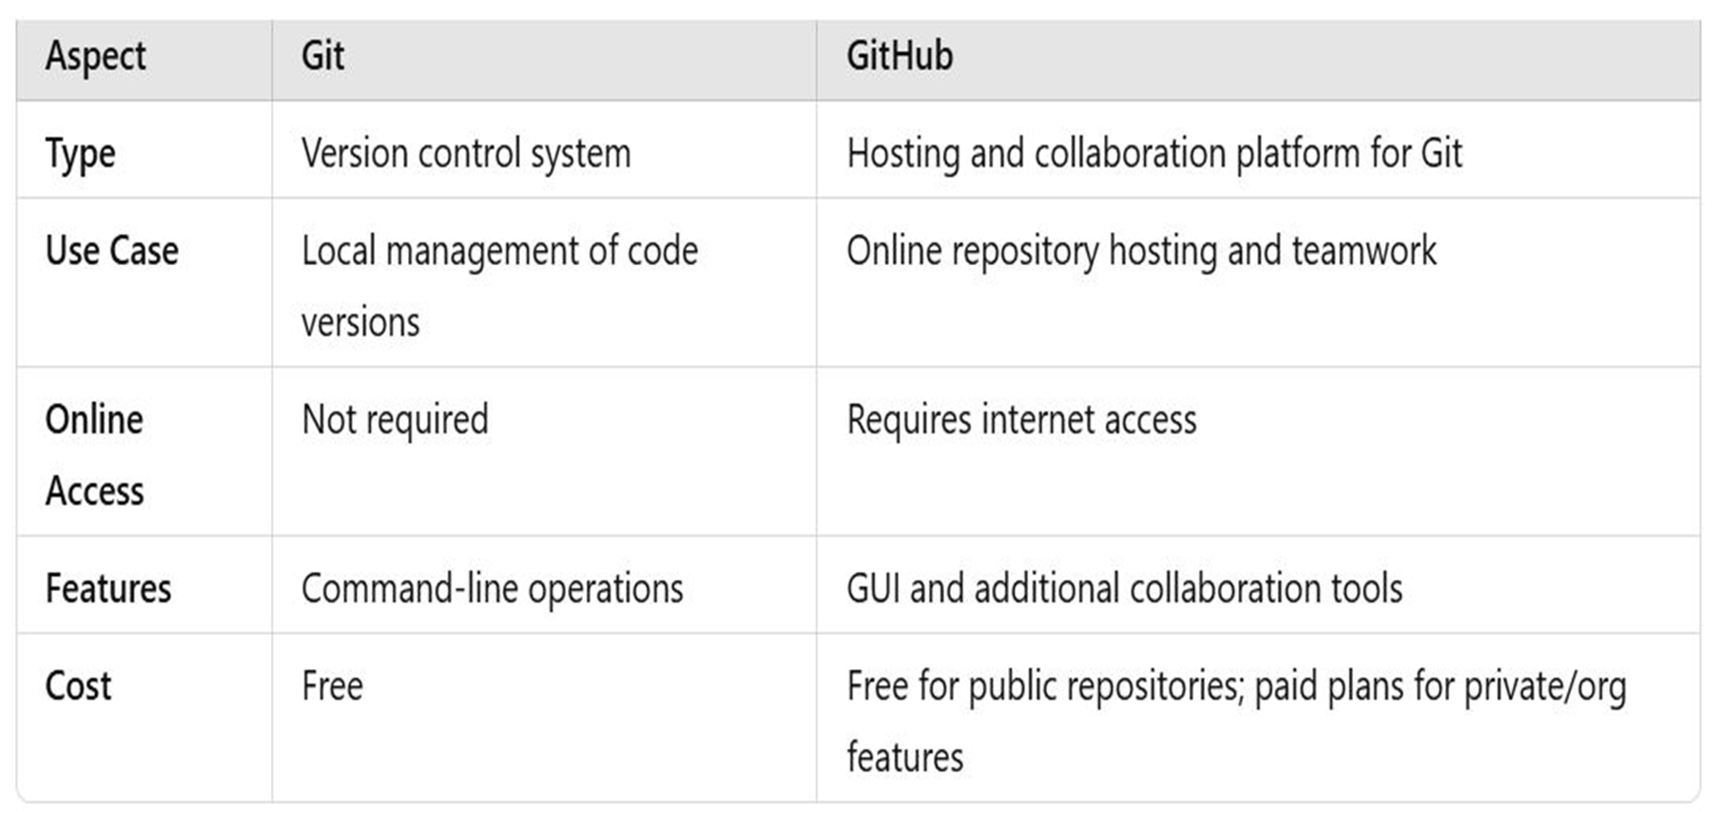
Git vs. GitHub

Slide 19
How Git and GitHub Work
Together
Create a Repository: Start a new project locally with Git.
Push to GitHub: Host your repository remotely using GitHub.

Slide 20
cont’
Collaborate: Use GitHub for pull requests, issue tracking, and code reviews.
Sync Changes: Use Git commands (git push/git pull) to synchronize local and remote repositories.

Slide 21
Thank You

